Slide 1


PARALLEL PROGRAMMING WITH V3-8 TPU
SUPERVISOR :
PROF.DR. Alexander Iliev
SUBMITTED BY :
AMEYA PRASANNA MOTE – 3104966@stud.srh-campus-berlin.de
HIMANI - 3104834@stud.srh-campus-berlin.de
NANMA JOSEPH –3104969@stud.srh-campus-berlin.de
GROUP 2
AI USE CASES (HSBE-BIS-BD-0014)

Slide 2








INDEX :
Objective
Tools/Frameworks used
Introduction to parallel programming
Application areas
Pros and cons
Introduction to CPU, GPU and TPU
Code
References

Slide 3
OBJECTIVE :
We have a wide variety of different flower species in the world like one species that have many colors for example like rose.
It has been very difficult to always remember and also determine their information of what type they belong to .
Some of them may belong to same species but might have different colors or different petals .
So it has been very difficult to identify and recognize different plants based on their flower or petals.

Slide 4
OBJECTIVE:
So it has been very difficult to identify and recognize different plants based on their flower or petals.
However detecting these different kinds of plants have been an expensive, time consuming and also have not produced accurate results.
So crossing out all these different challenges, the researchers have ended up in using image processing methods for detecting plant types.
Image processing and different machine learning techniques have played a vital role in detecting and recognizing different flowers .

Slide 5
OBJECTIVE :
In order to make a fast & robust image processing model, we will use the method of parallel processing.
Hence the motto of our project is that we will be focusing on detecting and classifying different plants based on their flower images , with the help of parallel programming on a image processing model .
We will use the v3-8 TPU (from kaggle)to train our model which will allow us to train the model on all 8 cores i.e,by allowing us to run more than one instruction at a time.
We will then compare the time elapsed in the model train with TPU with time elapsed in model training with single processor in order to check the accountability of TPU.

Slide 6
TOOLS/FRAMEWORK USED :
Python- base code- 3.8
IDE : Kaggle notebook
Framework : TensorFlow- 2.3
Open CV
Pandas
Pytorch

Slide 7
INTRODUCTION : PARALLEL PROCESSING :
In simple words, it is the use of multiple resources to solve a problem.
This type of programming takes a problem, breaks it down into a series of smaller steps, delivers instructions, and processors execute the solutions at the same time.
It is designed to program algorithms and applications on parallel computers.
High-level languages decrease both the design time and the execution time of parallel applications, and make it easier for new users to approach parallel computers.

Slide 8




INTRODUCTION : PARALLEL PROCESSING
Many computers, such as laptops and personal desktops, use this programming in their hardware to ensure that tasks are quickly completed in the background.
This type of programming can be used for everything .
from science and engineering to retail and research.
It’s most common use from a societal perspective is in web search engines, applications, and multimedia technologies.

Slide 9
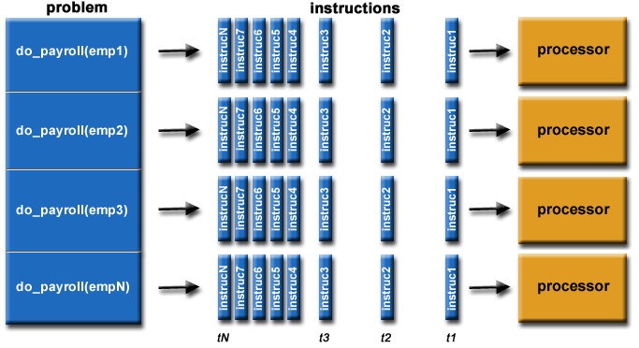
INTRODUCTION : Parallel Processing
Here a problem is cut down into different parts which could be solved concurrently .
Again, these parts are further divided into different series of instructions .
These instructions are from every part is now used simultaneously for executing on different processors .
Image Source

Slide 10
Why Parallel Processing?
There are many large and complex problems which literally can’t be solved using serial processing with limited computer memory.
Parallel processing mainly provides concurrency.
with the use of a single computing resource we are able to perform only one thing at a time.
Multiple number of different computing resources can do as many things as possible.

Slide 11
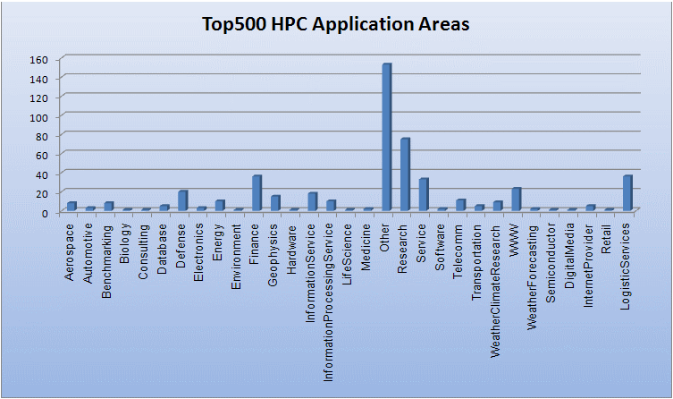
Parallel Processing Applications
SCIENCE AND ENGINEERING : | INDUSTIRY AND COMMERCIAL APPLICATIONS :
Atmosphere, Earth, Environment | Artificial intelligence and big data .
Bioscience- Biotechnology, Genetics | Medical imaging and diagnosis
Chemistry - Molecular Sciences | Oil exploration
Mechanical Engineering - from prosthetics to spacecraft | Networked video and multi-media technologies
Defense- Weapons | Pharmaceutical design
Electrical Engineering - Circuit Design, Microelectronics | Advanced graphics and virtual reality, particularly in the entertainment industry .
Image Source

Slide 12




Parallel Processing: Pros
There are two major advantages to using this programming over concurrent programming:
One is that all processes are sped up when using parallel structures, increasing both the efficiency and resources used in order to achieve quick results.
Another benefit is that parallel computing is more cost efficient than concurrent programming simply because it takes less time to get the same results.
This is incredibly important, as parallel processes are necessary for accumulating massive amounts of data into data sets that can be easy to process or for solving complicated problems.

Slide 13
Parallel Processing: Cons
The first is that it can be difficult to learn; programming that targets parallel architectures can be overwhelming at first, so it does take time to fully understand.
Additional, code tweaking is not straightforward and must be modified for different target architectures to properly improve performance.
It’s also hard to estimate consistent results because communication of results can be problematic for certain architectures.
Finally, power consumption is a problem for those instituting a multitude of processors for various architectures; a variety of cooling technologies will be required in order cool the parallel clusters.

Slide 14


CPU, GPU & TPU
While we know parallel programming can be done with CPU, GPU & TPU but let’s first understand these terms when we are talking about parallel programming.
We all have been at a point where the performance hit a cap and started to experience various degrees of processing lag.
Tasks that used to take minutes with smaller training dataset now started taking hours together to train large dataset .
And to solve these issues We have to upgrade our hardware accordingly and for that purpose we need to understand the difference between different Processing Units.

Slide 15
CPU(Central Processing Unit)
It takes instructional inputs from the computer's RAM,decodes & processes the action before delivering an output.
CPU is used for general purpose programming.
A processor designed to solve every computational problem in general fashion.
The Memory and Cache are designed to be optimal for any general programming problem and can handle different programming languages like(C,Java,Python).

Slide 16
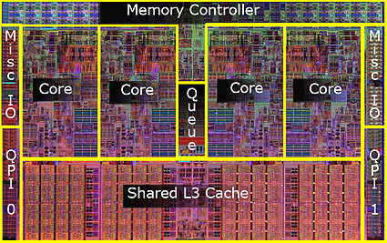
CPU(Central Processing Unit)
For example, let’s take the instance of intel core I7. It has several features such as:
Four independent CPU cores.
Two way multi threading per CPU core.
Integrated L1, L2 & L3 caches.
The intel core I7 processor achieves the high performance through its multiple cores & simultaneous multi threading
Image Source

Slide 17
GPU(Graphics Processing Unit)
Graphical processing Unit is familiar name to many gamers.
Initially designed mainly as dedicated graphical rendering workhorses of computer games .
GPUs were later enhanced to accelerate others like photo/video editing, animation, research and other analytical software, which need to plot graphical results with a huge amount of data.
As a general rule, GPUs are a safer bet for fast machine learning because, at its heart, data science model training is composed of simple matrix math calculations .

Slide 18
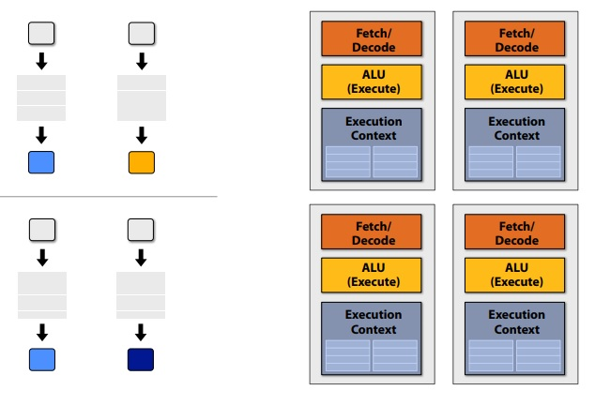
GPU(Graphics Processing Unit)
Use many cores & run them in parallel (shown in this figure).
GPU shares instruction stream across many fragments.
Interleave processing of many fragments on a single core.
They can handle tens of thousands of operations per cycle, the dimension of data is generally 1 x N data unit.
For this reason GPU has thousands of ALU in single processor, that means you can perform thousands of multiplications and addition simultaneously.
Image Source

Slide 19
NPU(NeuralProcessing Unit)
A neural processing unit is a microprocessor that specializes in the acceleration of machine learning algorithms.
Consume low power & improve resource utilization for machine learning tasks as compared to GPUs & CPUs.
Cannot be used for general purpose computing such as CPU.
It supports computations faster 10K times than GPUs.
Low power consumption & resource utilization improvement.
Examples of NPUs are; “Samsung Mobile NPU”, “TPU by Google”, “Neural Engine by Apple”, ”Ali-NPU by AliBaba”

Slide 20
TPU(Tensor Processing Unit)
Proprietary Processor designed by Google for use in neural networks.
Because GPU performs parallel computation on thousands ALUs, so it also spends more energy on memory accessing. To overcome this problem Google designed TPU.
Tensor processing Unit (TPU) is a ASIC processor which is Application Specific Integrated Chip designed to accelerate deep learning tasks developed using Tensorflow framework.
It’s not a generic processor. It can only handle tensorflow model on it.
So the output will be the summation of all multiplication result between data and parameters.

Slide 21
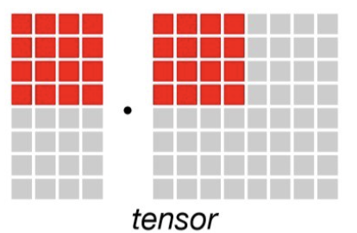
TPU(Tensor Processing Unit)
TPU can handle upto 128000 operations per cycle and the dimension of data are NxN data Unit.
Compilers have not been developed for TPU which could be used for general purpose programming hence,it requires significant effort to do general programming on TPU.
After that, TPU loads the data from memory. As each multiplication is executed, the result will be passed to next multipliers while taking summation at the same time.
It supports computational resources such as; “Matrix Multiplier Unit”, ”Unified Buffer”, “Activation Unit” .
Image Source

Slide 22
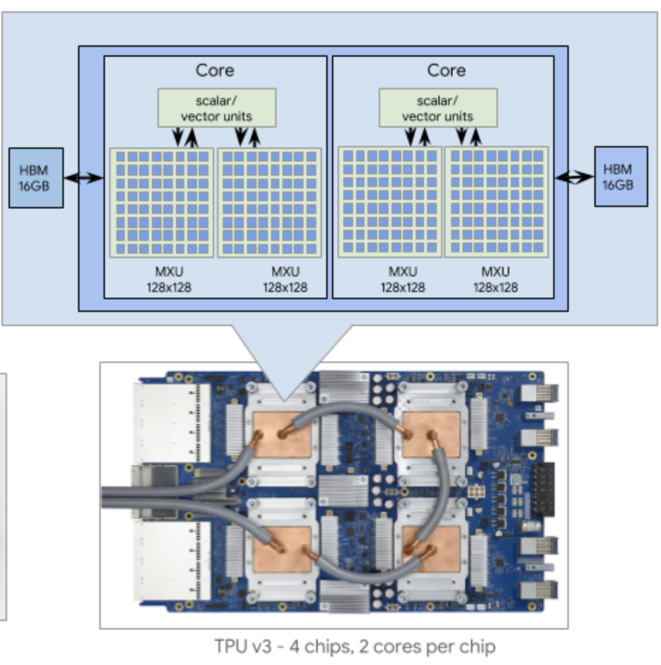
TPU V3(Tensor Processing Unit)
16 GM of HBM for each TPU core.
Two MXUs for each TPU core.
Upto 2048 total TPU cores & 32 TB of total memory in a TPU pod.
The TPU type that you select for your TPU node determines how many devices are available for your workload.
The TPU node compiles the computation graph just in time and sends the program binary to one or more TPU devices for execution.
Image Source

Slide 23
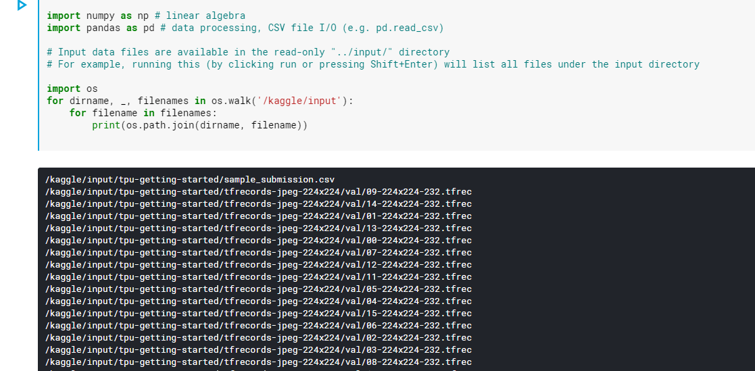
CODE - TPU :
Import all required python packages

Slide 24
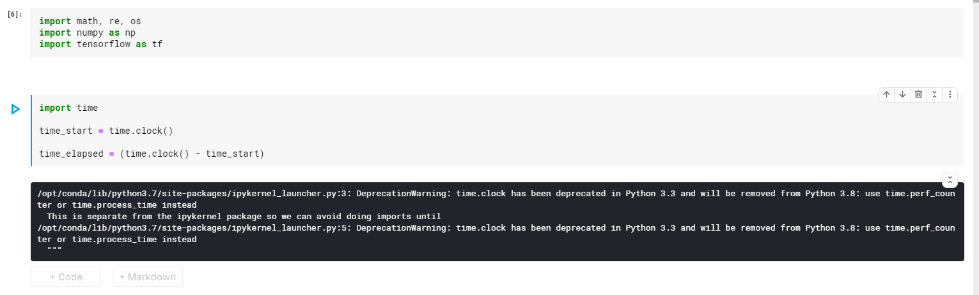
CODE - TPU :
time.clock returns the current processor time as a floating point number expressed in seconds

Slide 25
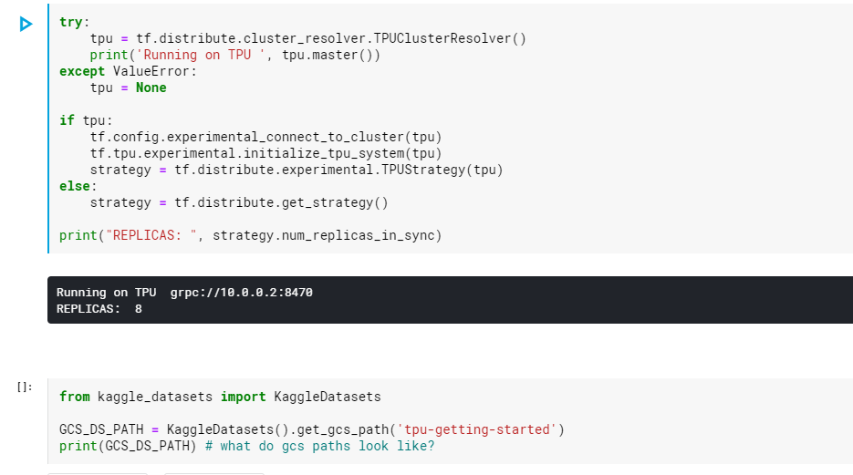
CODE - TPU :
Using the distribution strategy we tell the tensorflow to make use of all 8 cores at once.
When used with TPUs, datasets need to be stored in a Google Cloud Storage bucket. You can use data from any public GCS bucket by giving its path.

Slide 26
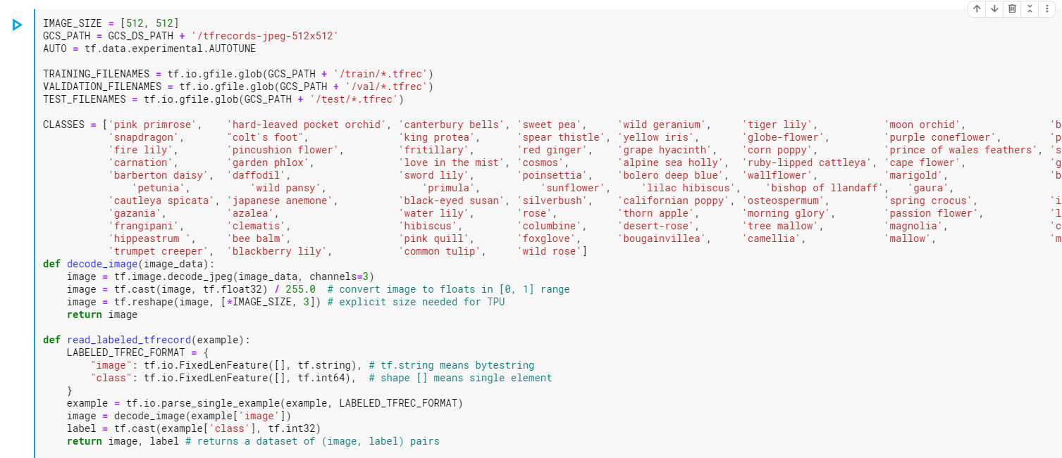
CODE - TPU :
When used with TPUs, datasets are often serialized into TFRecords.
This is a format convenient for distributing data to each of the TPUs cores.

Slide 27
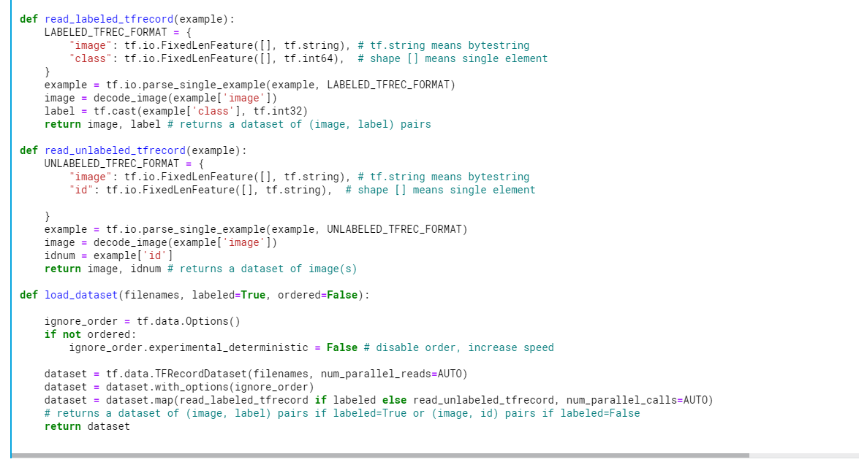
CODE - TPU :
converted to tensors so that it will be a valid input in our model
parse out the image and the target values.
We have to decode the data by converted to tensors so that it will be a valid input in our model. As images utilize an RGB scale, we specify 3 channels.
Our dataset is not ordered in any meaningful way, so the order can be ignored when loading our dataset. By ignoring the order and reading files as soon as they come in, it will take a shorter time to load the data.

Slide 28
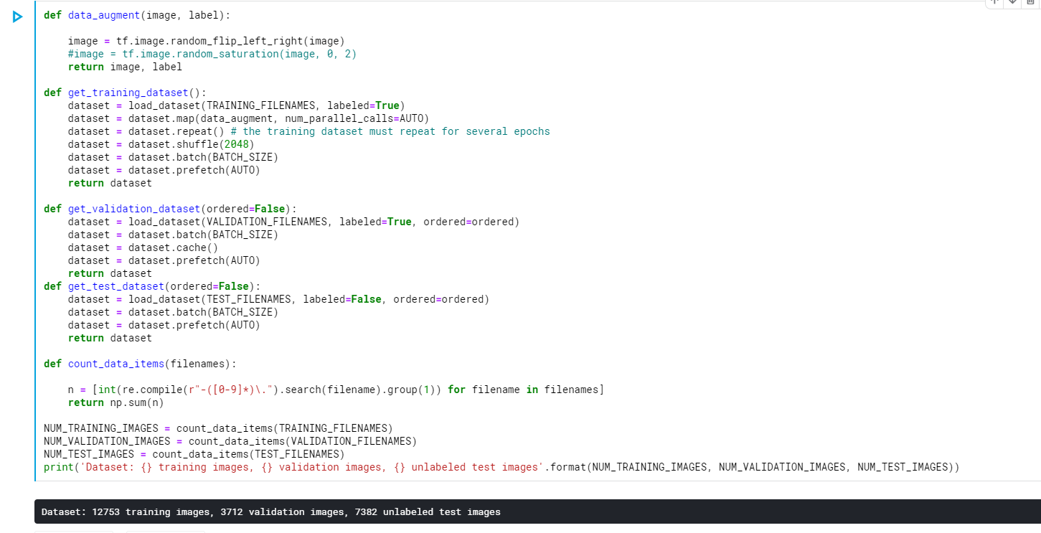
CODE - TPU :
Now we will use the tf.data API to define an efficient data pipeline for each of the training, validation, and test splits.

Slide 29
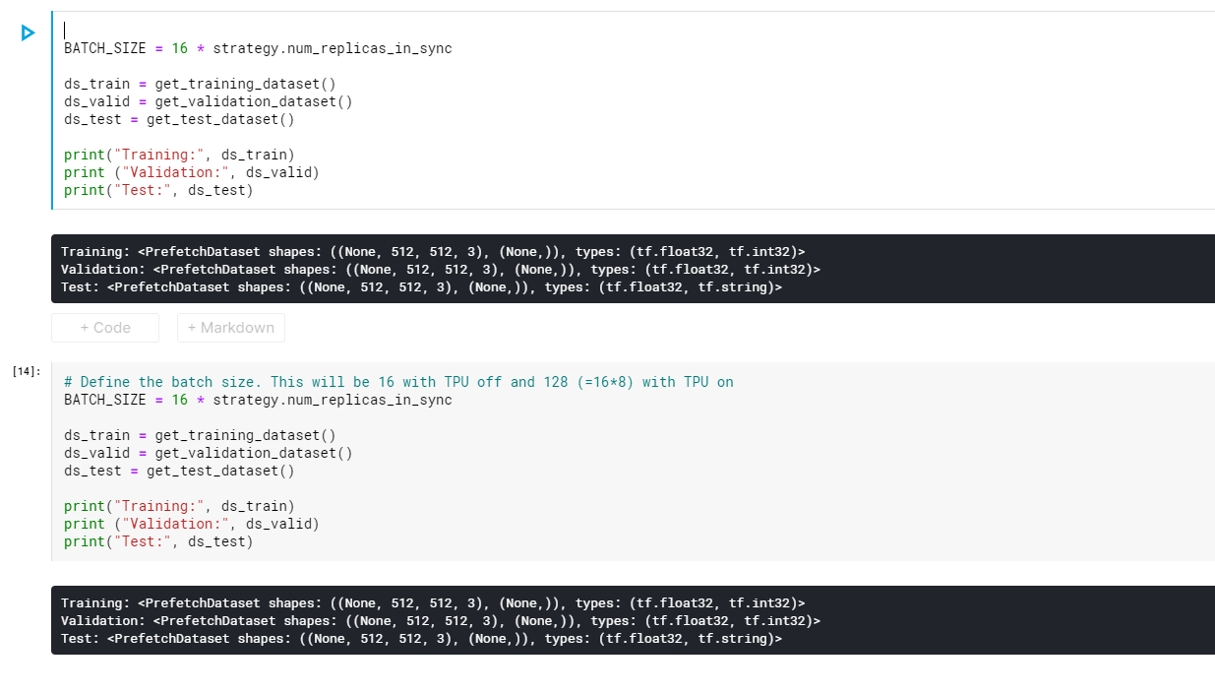
CODE - TPU :
This will create the datasets that we'll use with Keras during training and inference. Notice how we scale the size of the batches to the number of TPU cores.
After defining the batch size there will be 16 with TPU off and 128 (=16*8) with TPU on.

Slide 30
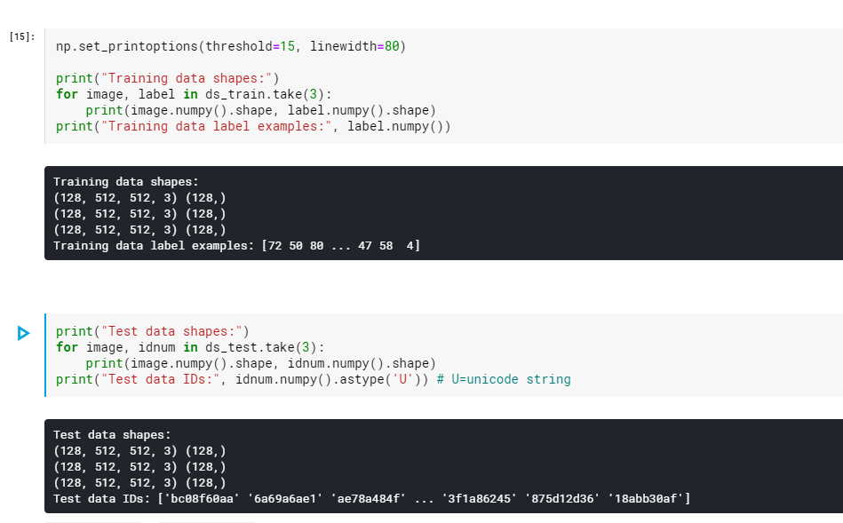
CODE - TPU :
Here we are printing the training & test data set shapes.
These datasets are tf.data.Dataset objects.The training and validation sets are streams of (image, label) pairs & the test set is a stream of (image, idnum) pairs; idnum

Slide 31
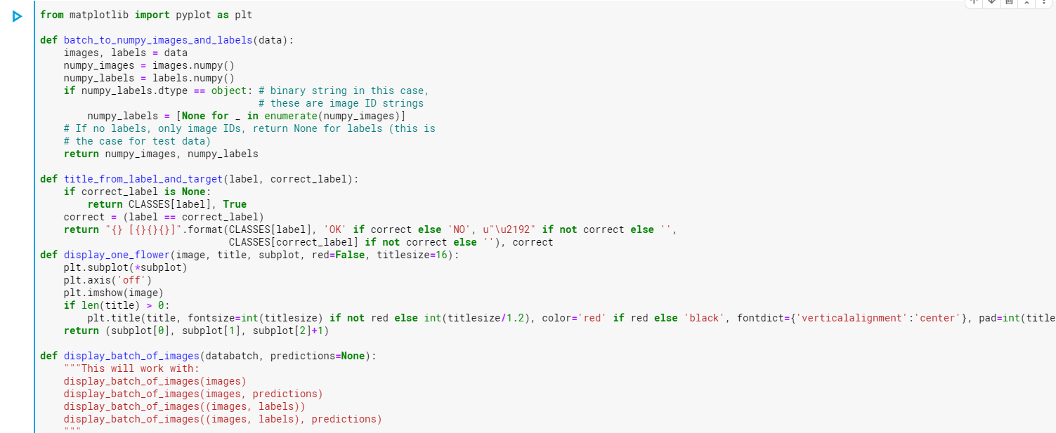
CODE - TPU :
Before any Machine Learning, it is always important for the user to get to know the dataset better. In here, Using visualization tools, we understand the dataset so that we are informed.

Slide 32
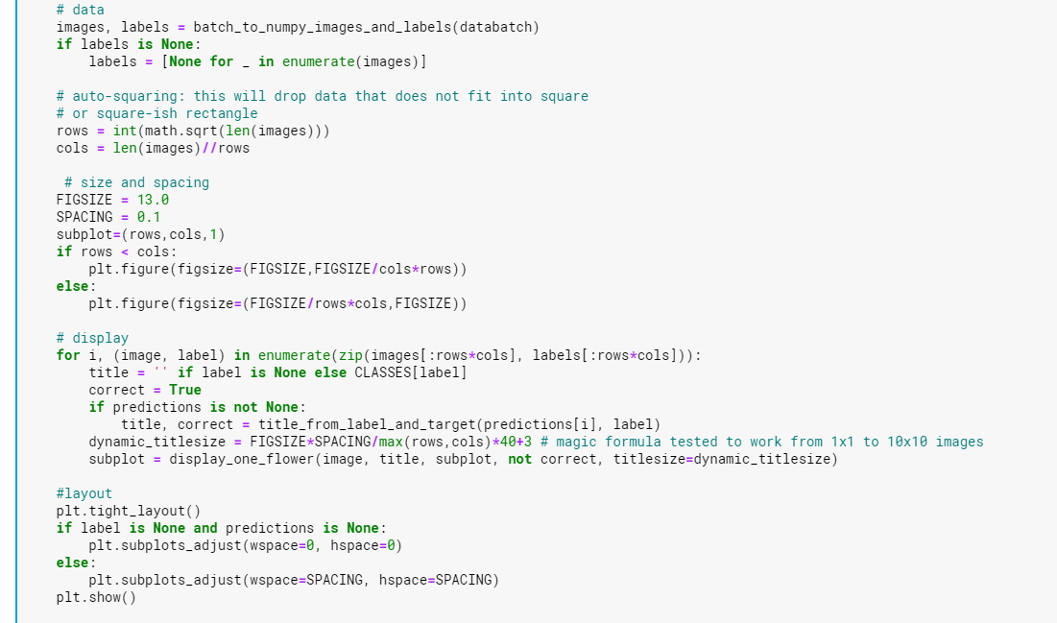
CODE - TPU :

Slide 33
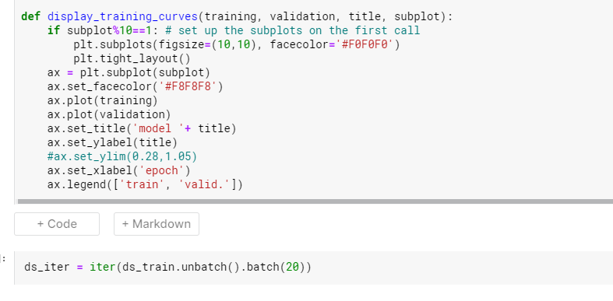
CODE - TPU :
You can display a single batch of images from a dataset with another of our helper functions. The above cell will turn the dataset into an iterator of batches of 20 images.

Slide 34
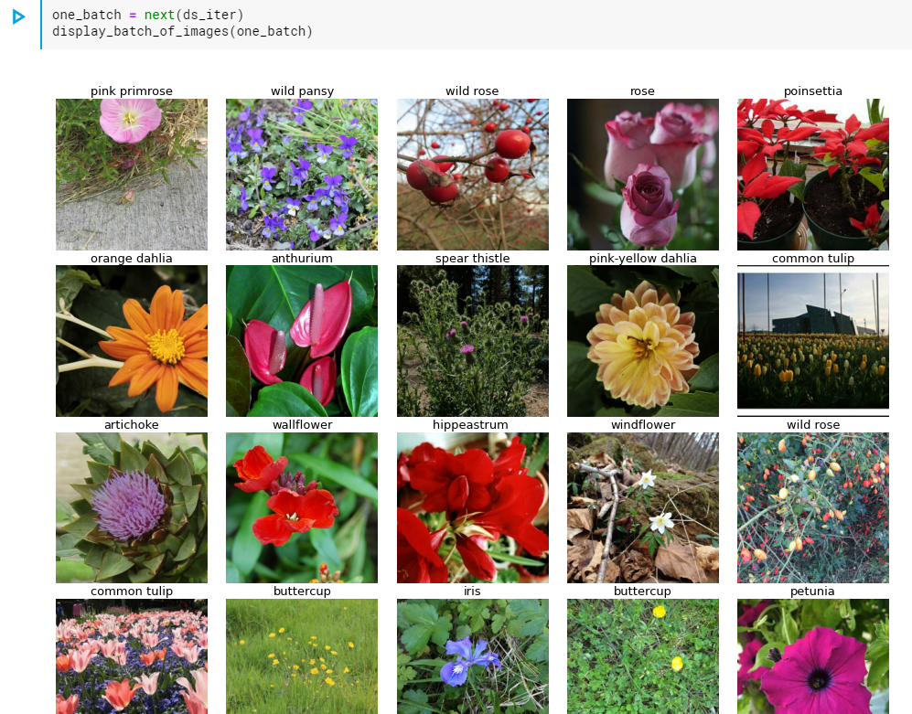
CODE - TPU :

Slide 35
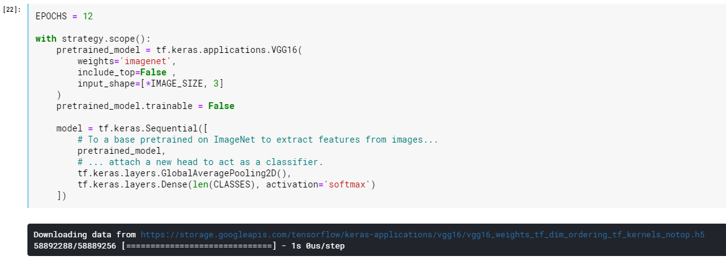
CODE - TPU :
Now we're ready to create a neural network for classifying images.
We will use the Vgg16 model which is pretrained model on imagenet.
The distribution strategy we created earlier contains a context manager, strategy.scope. This context manager tells TensorFlow how to divide the work of training among the eight TPU cores.

Slide 36
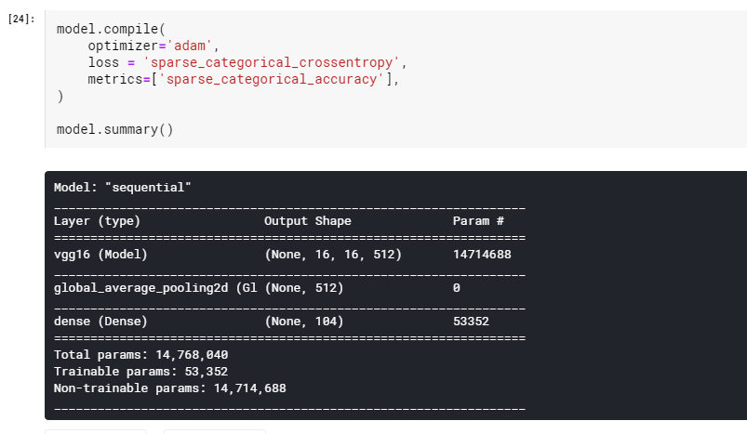
CODE - TPU :
Here the model is getting compiled & the 'sparse_categorical' versions of the loss and metrics are appropriate for a classification task with more than two labels, like this one.

Slide 37
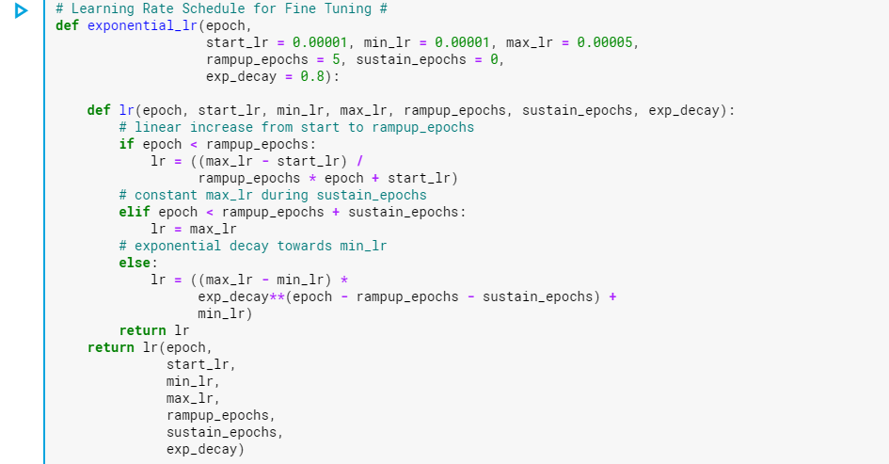
CODE - TPU :
lr schedule
We'll train this network with a special learning rate schedule.

Slide 38
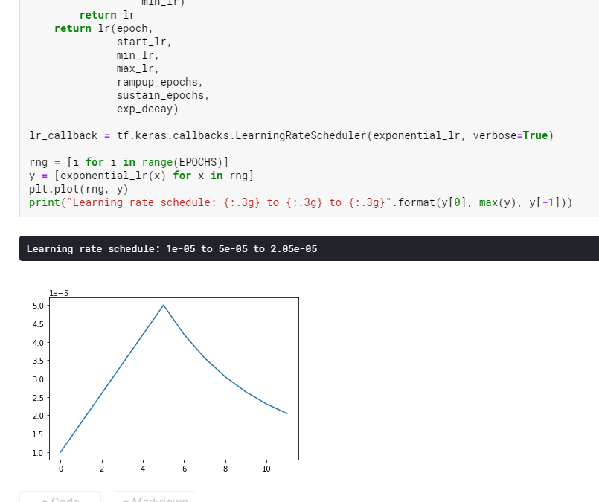
CODE - TPU :

Slide 39
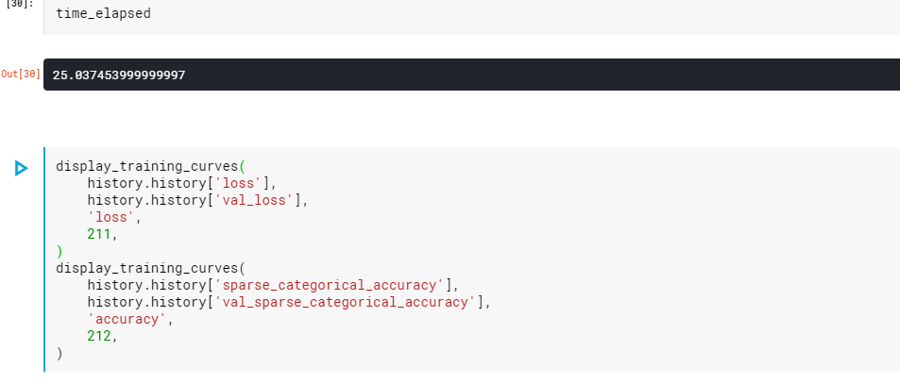
CODE - TPU :
This is the time elapsed while training the model.

Slide 40
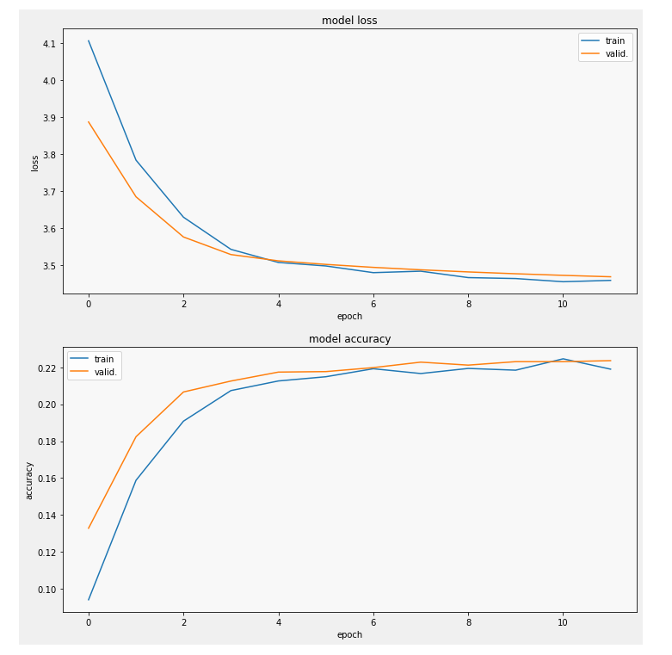
CODE - TPU :
This graph shows how the loss and metrics progressed during training

Slide 41
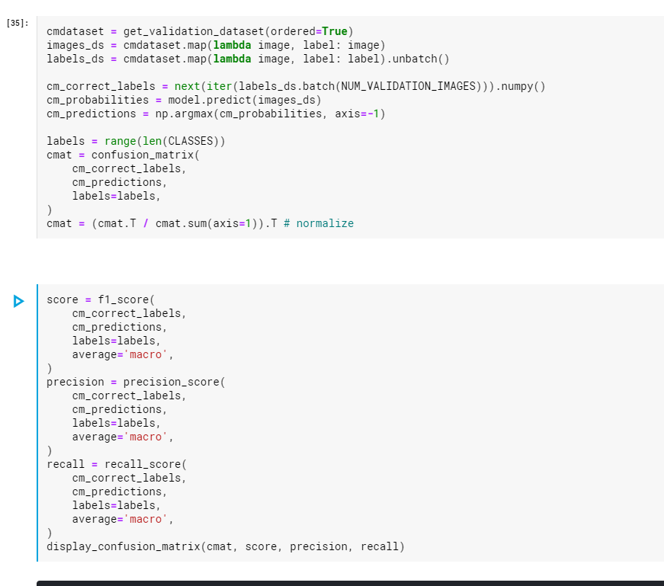
CODE - TPU :
Here we will compute these metrics and display them with a plot of the confusion matrix. (These metrics are defined in the Scikit-learn module sklearn.metrics.

Slide 42
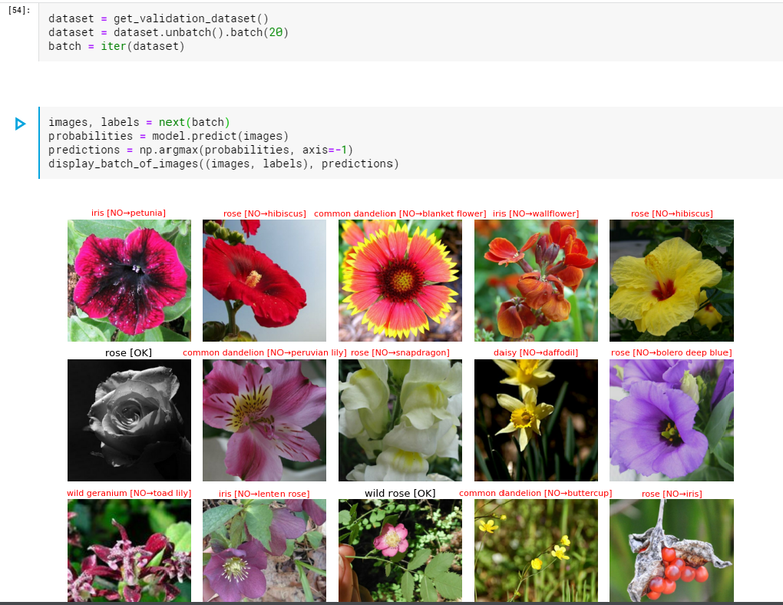
CODE - TPU :
And here is a set of flowers with their predicted species

Slide 43
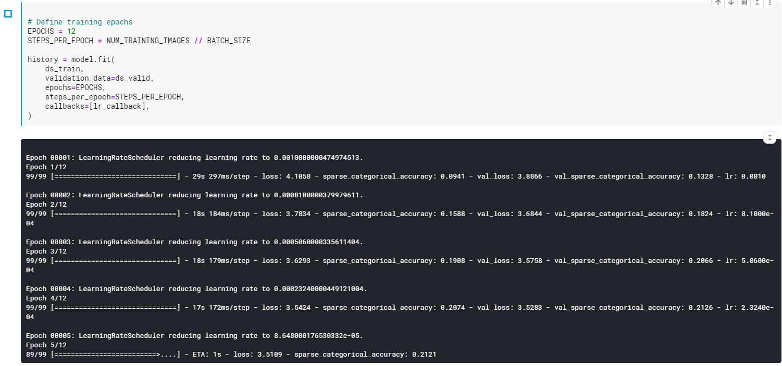
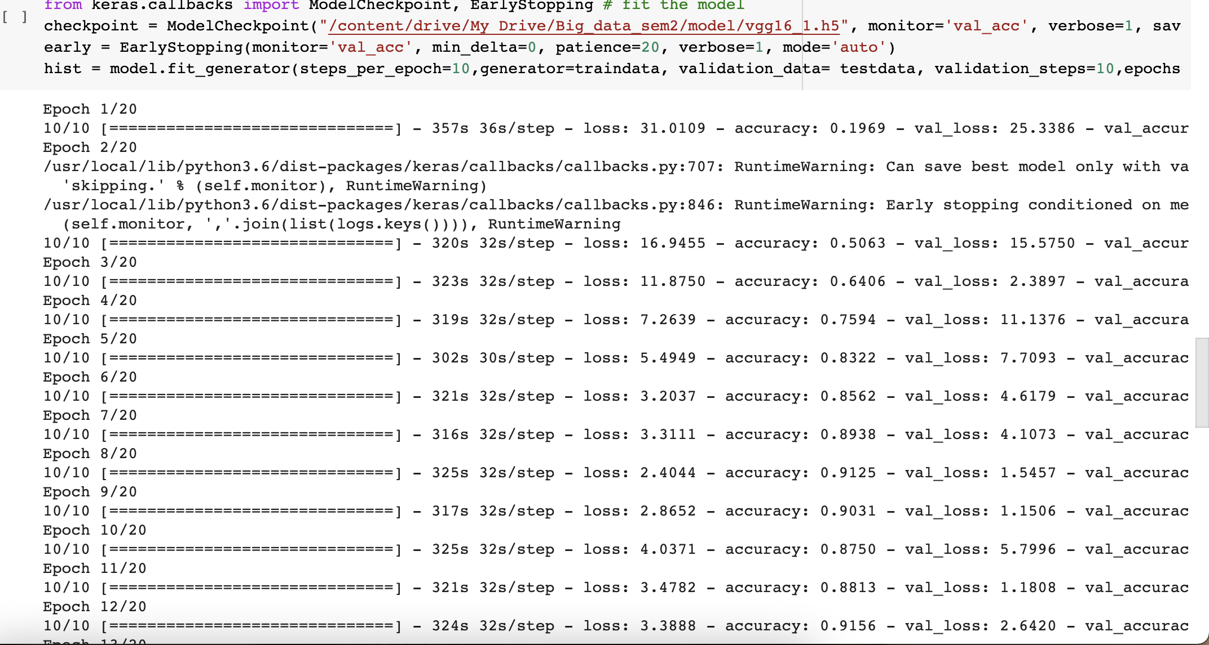
TPU Vs Single processor:
From the above results we can see program running with TPU is very fast as each epoch is taking approx 15-20 sec on an average whereas program ran on single processor is taking almost more than 3 minutes for each epoch.

Slide 44
REFERENCES :
https://hpc.llnl.gov/training/tutorials/introduction-parallel-computing-tutorial#Overview
https://www.kaggle.com/docs/tpu
https://www.kaggle.com/ryanholbrook/create-your-first-submission
https://www.bestcomputersciencedegrees.com/faq/what-is-parallel-programming/#:~:text=In%20very%20simple%20terms%2C%20it,solutions%20at%20the%20same%20time.
https://medium.com/analytics-vidhya/cpu-gpu-tpu-ml-perspective-1f049cd4d43d
https://www.youtube.com/watch?v=fO61V5Qiyf4&list=WL&ab_channel=MarcellinKhoury

Slide 45
Thank You

